Slide 1

crafted design
sandromancuso
an introduction to Interaction-Driven Design (IDD)
Notes:
In this talk I’ll be sharing how I’ve been designing software in the past few years. I’ll be talking about a design style that I’m calling Interaction-Driven Design (IDD)
To be catchy it needs to be Japanese or xDD. Chose the latter cos I don’t speak Japanese.

Slide 2
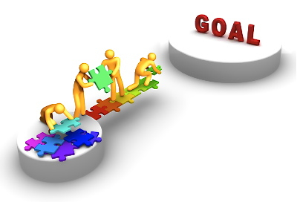
What is this application about?
What are the main concepts?
What does this application do?
What are the main features?
Where do I change it?
Where do I add a new feature or fix a bug?
Notes:
For years I’ve been trying to find ways to, while looking from above, answer the following questions:

Slide 3
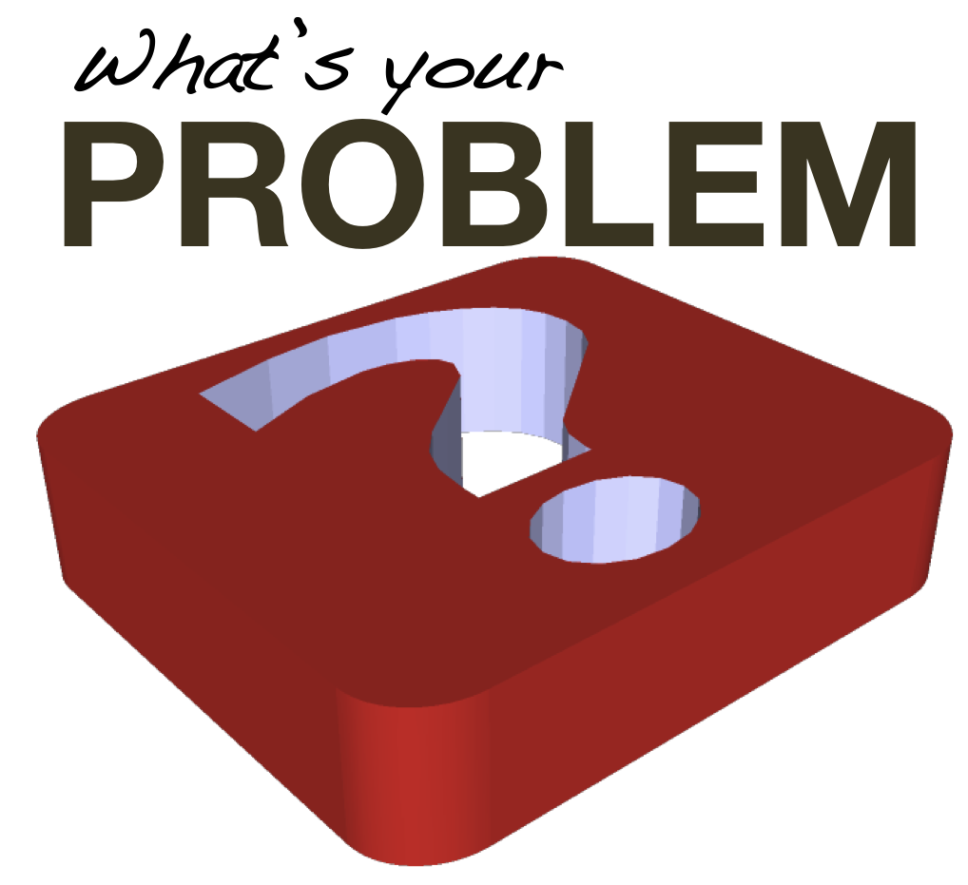

Badly structured packages/namespaces
Architectural and design concepts mixed with domain
Classes and methods are too low level
Acceptance tests either absent or badly written
Notes:
Looking from above: controllers, repositories, managers, services, etc.
Layers vs. domain? How do they fit together?
How many of you are happy with your package structure?

Slide 4
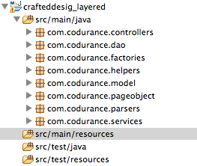
Example: Layered structure
Notes:
Confusing. I have no idea what this application is about or what it does.
What does this application do? What is it about?

Slide 5
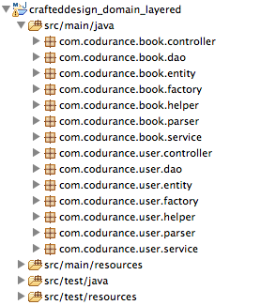
Example: Layered-domain structure
Notes:
Gives me some information on what the application is about but not what it does.
Loads of duplication
Very poluted
Books and Users. Cool, but what does this application do?

Slide 6
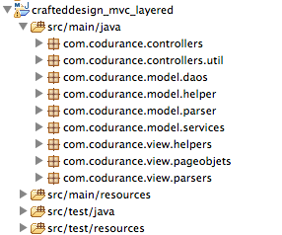
Example: MVC structure
Notes:
Once again, gives me no information on what the application is about or what it does.
But I know it is a web app though. Sigh.
Awesome. It’s a web application. So?

Slide 7
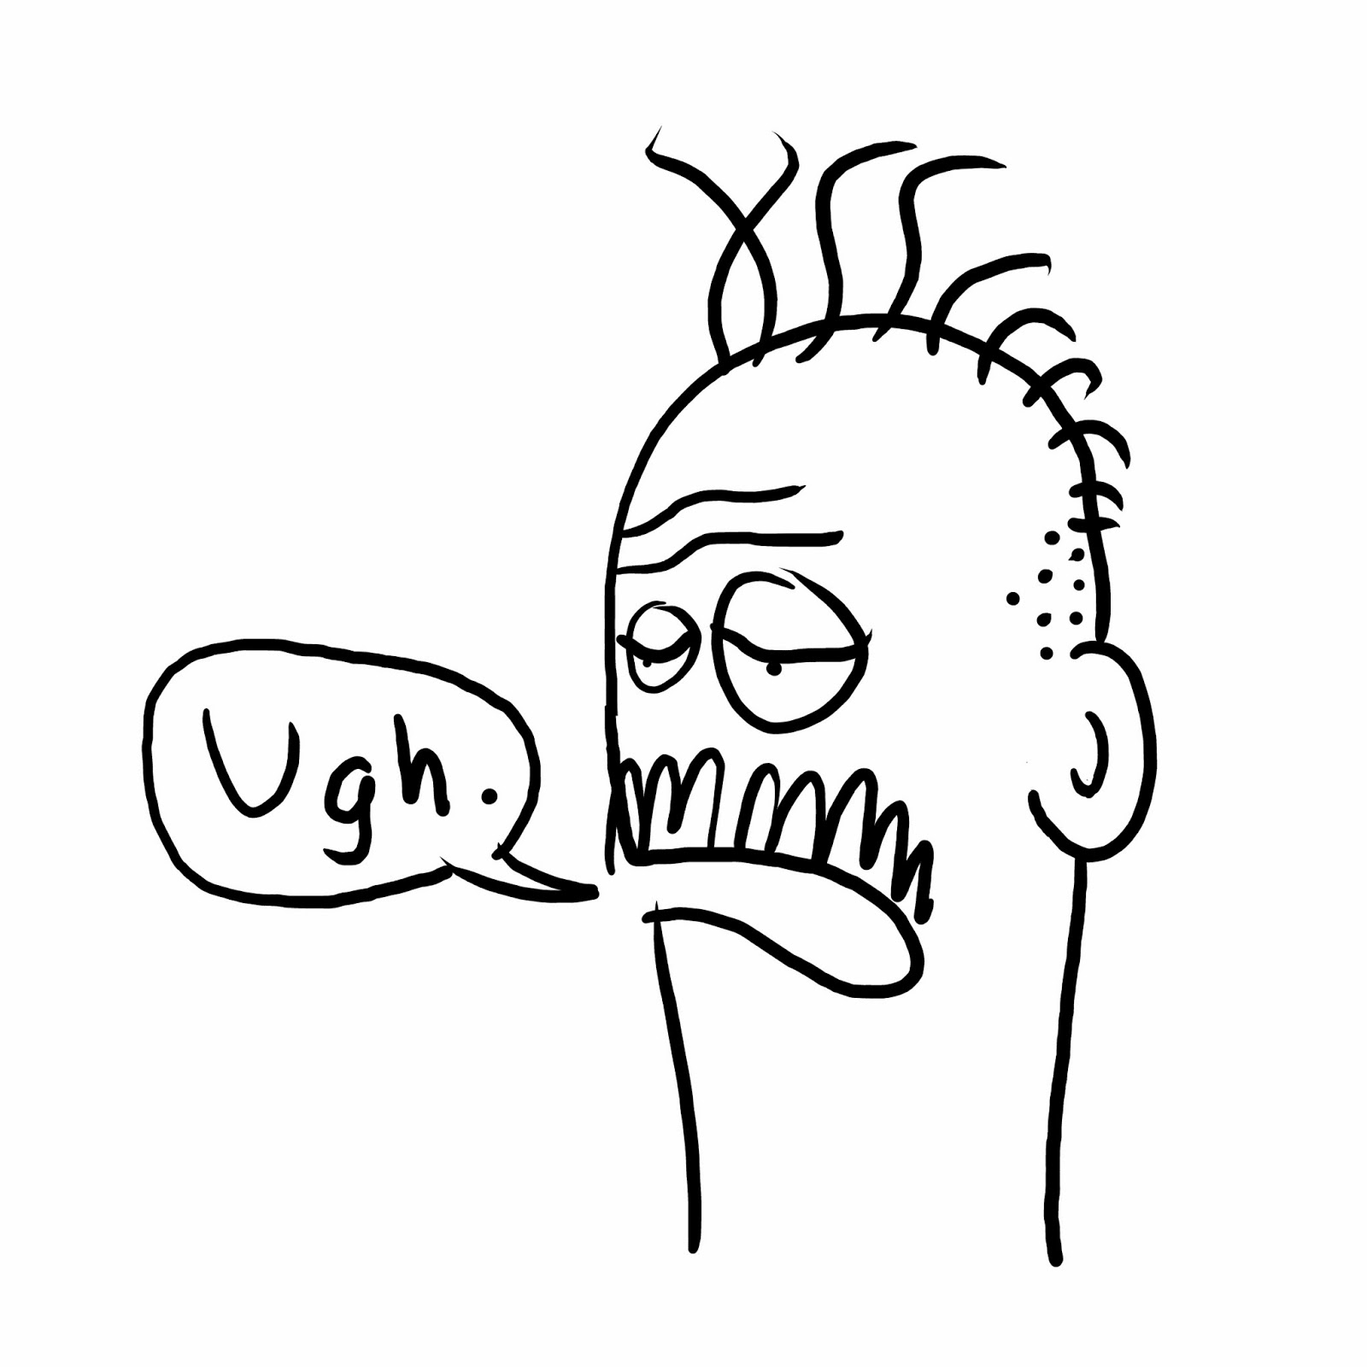
Notes:
So, how do I solve the problem? How do I answer the questions?
But first things first…
Before getting into how I’m organising/structuring my code, we need some background to justify my decisions

Slide 8
MVC & MVC Variations
MVC (Smalltalk 76/80)
MVC (general concept – 1988)
Three-Tier Architecture (Presentation, Logic, Data)
MVC (Model 1/Model 2)
Model View Adapter (MVA)
Model View Presenter (MVP)
Model View ViewModel (MVVM)
Presentation-Abstraction-Control (PAC)
….
Notes:
It was only later, in a 1988 article in Glenn E. Krasner and Stephen T. Pope that MVC was expressed as general concept, in the The Journal of Object Technology

Slide 9
Views impact MVC structure
Depending on the view technology, Views and Controllers responsibility becomes more/less coupled or blurred.
Traditional multi-page web applications
Single-page AJAX applications with stateless backend
Console-based applications
Desktop applications
Games
Mobile / tablets
External systems (talking via Queues / Webservices)
However, the model should remain unchanged.

Slide 10
MVC used badly
Anaemic Domain
Fat Controllers
Coupling with MVC framework
Notes:
Anaemic Domain: Model is only composed by entities and data structures
Fat Controllers: Without a place to put business logic, the logic is put on the controllers

Slide 11
MVC – A Macro Organisational Pattern
V
C
M
Model
?
Delivery
Mechanism
Notes:
What should we have in the model? What is model?

Slide 12
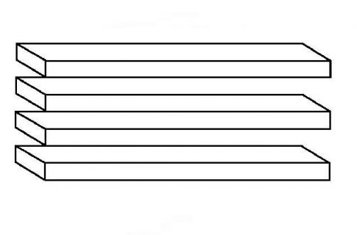
“Model” is overloaded and confusing
Model (M in MVC)
Domain Model (DDD)
View Model
Data Model
Entities & Active Record
and other artificial definitions from MVC frameworks
Associated with the persistence mechanism?

Slide 13

M => Domain Model (DDD)
Domain Model combines state and behaviour, with more focus on the latter.
DDD define a few building blocks to your domain:
Entities
Value Objects
Factories
Repositories
Services
Application
Domain
Infrastructure
Aggregates

Slide 14
View, Controller, Domain Model
V
C
DM
Model
Queue
DB
Delivery
Mechanism
Notes:
Start our application with this clear separation or refactor towards it.
Keeping them separately gives us options.

Slide 15
Embedded Domain Model
<< Web app >>
V
C
DM
Model
Infrastructure
Infrastructure
Queue
DB
Delivery
Mechanism
Notes:
Domain Model embedded in a Web Application
V/C belong to the application (main)

Slide 16
Deployable Domain Model
<< mobile app >>
<< deployable app >>
Model
DM
<<W/S>>
<< external system >>
<<W/S>>
Infrastructure
Delivery
Mechanisms
DB
Notes:
Domain Model wrapped in a deployable application
Expose a W/S for mobile apps / Web apps / External Systems
This is similar to Hexagonal Architecture (Ports & Adapters belong to Infrastructure)
Mobile app could have the V/C

Slide 17
Event-Driven Domain Model
<<event 1>>
<< external app 1 >>
<< deployable app >>
Queue
Model
DM
<< external app 2 >>
Queue
Infrastructure
Delivery
Mechanisms
DB
<<event 2>>
Notes:
Event-Driven application

Slide 18
Domain Model building blocks & responsibilities
Model
DM
R 1
DS 1
A 1
<< web app >>
DS 2
A 2
R 3
DS 3
S
Infrastructure
Impl
Impl
A = Action, DS = Domain Service, S = Infra. Service, R = Repository
Notes:
- Actions are the entry point to the domain model (control flow delegating to Domain Services)
- Actions can use factories to create domain objects according to the input (normally not in the domain format)
- Domain Services are the entry point to a domain concept.
Repositories are helpers to the Domain Service and should not be exposed.

Slide 19
Behaviour: Action, Domain Service or Entity?
Action
Defines the action our domain model will be asked to perform.
Behaviour related to multiple instances of the same entity or different entities.
Behaviour that doesn’t fit any specific entity.
Domain Service
Entity
Behaviour related to the data of a single instance of an entity

Slide 20
Repositories (not DAOs)
Model
Domain Model
<<repository>>
Users
<<repository>>
Library
Infrastructure
<<Oracle>>
Users
<<Mongo>>
Books
“A Repository represents all objects of a certain type as a conceptual set. It acts like a collection, except with more elaborate querying capability.”
~ Eric Evans
Notes:
- I name repositories using the plural (collection) of the domain concept they represent (Users, Books)
Repository vs. DAO (Former behaves as a collection. Latter is a pattern to access data)
Data Access Object (DAO) is a commonly used pattern to persist entities (data) into a database. (CRUD)

Slide 21
An example would be good…
User Account
Checker
Users
valid account?
has prime account?
validate
Payment
Validator
Make Payment
Payment Gateway
pay
<<interface>>
Card Processor
process card
Order
History
store order
Orders
email confirmation
<<interface>>
Email Sender
Action
Domain Service
Infra. Service
Repository
Class

Slide 22
Class responsibility
Domain Model entry point
Domain Concept entry point
Produces the output
End of flow
Input
Output
C
A
DS
R
cl
First to handle input
Start of the flow
End of code branch
Execution Flow
Closer to the input: Control flow, higher level abstraction, detailed work is delegated (e.g. ProcessTrade (A), MakePayment (A)) — More suitable for Outside-In TDD (mockist).
Closer to the output / end of branch: Specific and detailed behaviour, no delegation, lower level abstraction (e.g. Parse XML (Parser), Create User (Repository))
Notes:
Classes closer to the output are more suitable for Classic TDD, unless they are close to the boundaries (that need to be mocked in both TDD styles)

Slide 23
Domain Model collaborations guideline
A 1
DS 1
R 1
X
DS 2
cl
C1
X
DS 3
cl
A 2
cl
DS 4
R 4
cl
C2
A 3
X
R 5
Except for read model
C = Controller, A = Action, DS = Domain Service, R = Repository, cl = class
Notes:
Controller can talk to one or more than one action
UC can talk to one or more DS or classes
DS can talk to other DS or Infra Service
Repositories are never exposed. Just accessed by its own DS. Exception is on Read Model

Slide 24
Command & Query Actions
Model
<<Write Model>>
A
DS
DB
R
<< web app >>
Queue
<<domain events>>
Model
A
R
DB
<<Read Model>>
Notes:
- Write model throws domain events
Query model listens to domain events and populate “read” DB
Query UC return data according to the application needs (Report, Complex Screen with denormalised data, etc)
Command Actions go though the domain model, delegating to domain services
Query Actions may go to a read model instead, querying with joins returning VOs that are specific to the UI.
No need to organise them in different packages (using command & query as names)

Slide 25
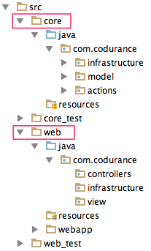
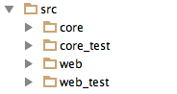
So, how does the app structure look like?
Notes:
Controllers talk the Actions
Controllers should be thin, invoking an action, and choosing the view to be displayed (maybe creating page objects or converting to JSON?)
web: View (page objects)
Web: Infrastructure (JSON / XML parsers or converters)

Slide 26
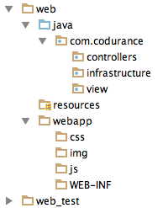
Web project responsibility
Delivery Mechanism: Defines the user journey
Control flow (invoke actions)
JSON / XML parsers or converters
View Models, validators, etc
Static files
Notes:
Controllers talk the Actions
Controllers should be thin, invoking an action, and choosing the view to be displayed (maybe creating page objects or converting to JSON?)
web: View (page objects)
Web: Infrastructure (JSON / XML parsers or converters)

Slide 27
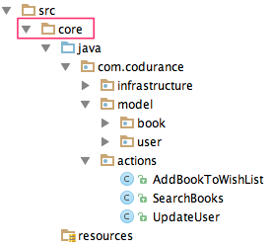
Core responsibility (simple project)
Tells what the system is about
Tells what the system does
Notes:
In a simple project (CRUD), action may be as simple as Insert, Delete, Update User
Not all action se cases have a direct correlation to entities (AddBookToWishList)

Slide 28
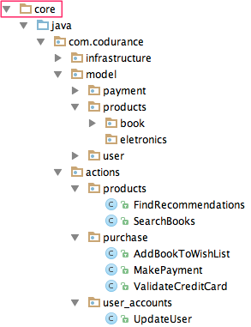
Core responsibility (bigger project)
Related domain concepts
Epic / Theme
Epic / Theme
Epic / Theme
Notes:
Epics/Themes: Candidates for bounded contexts / (micro?) services
MakePayment UC does not need to have a related Entity, neither FindRecommendations.
MakePayment may sent information out to a different system
FindRecommendations may return a list of products (after a very complicated logic, taking to consideration user attributes and buying patterns)

Slide 29
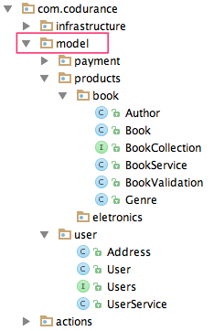
What is inside model packages?
Entity (part of Book aggregate)
Aggregate root (entity)
Repository
Domain Service
Part of aggregate behaviour
Value Object (part of Book aggregate)
Value Object (part of User aggregate)
Aggregate root (entity)
Repository
Domain Service
Notes:
Many of the DDD building blocks

Slide 30
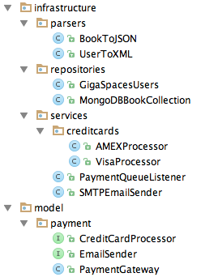
What is inside infrastructure?
Repository implementations
CreditCardProcessor implementations
Interfaces defined by the domain.
Dependency Inversion Principle (DIP)
Notes:
Decouples the architectural decisions and layers from the domain model.

Slide 31
Interaction-Driven Design – IDD (Outside-In design)
Input
Output
C
A
DS
R
cl
Execution Flow
Design Flow
Starting from the action, model the expected behaviour (outside-in)
Entities (data structures) will emerge in order to satisfy the behaviour
Focus is on the behaviour of the system and not on how data is stored/related
Notes:
A class API (public interface) should be designed from the client’s perspective.
Doing otherwise leads to over-engineering and YAGNI – You Ain’t Gonna Need It
Businesses are not interested in how data is stored or related. They are interested in the behaviour of the software.

Slide 32

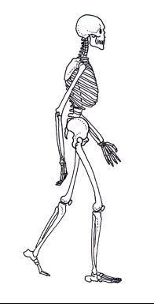
Feature
HTML
JSON
1 Horizontal
+
‘N’ Vertical slices
DB

Slide 33
Feature 4
DB
Feature 3
Feature 2
Feature 1

Slide 34
Defining testing strategies and boundaries
Types of tests
?
Unit
Integration
Acceptance
Journey
Black box
Component
System
Functional
Alpha
Beta
Conformance
…
Notes:
First, discuss with your team and define the scope of each test
Then, chose a name for each scope

Slide 35
Testing strategies: User Journey
Tests the journey a user will have to do something useful in the system
Designed according to User Stories and Features
Model
DM
<< web app >>
A 1
A 1
<<fake>>
A 2
<<fake>>
A 2
Application is tested as a black box normally using a BDD framework
Actions are faked. We just want to know if the application presents the user with the correct journey
Notes:
Mocking the backend makes these tests run really fast and predictable.
Easy to setup

Slide 36
Testing strategies: Acceptance (Action / Behavioural)
Tests a behaviour (action) provided by the system
Domain Model
Action is the entry point and all external dependencies are stubbed
A
DS 1
Normally tested using a BDD framework
DS 2
<<mock>>
R
R
Infrastructure
Impl
Notes:
Tests multiple classes together.
External dependencies are stubbed

Slide 37
Testing strategies: Integration
Tests the classes at the system boundaries
Domain Model
A
DS 1
DS 2
<<mock>>
R
R
Normally done using an in-memory Database using a unit testing framework
Infrastructure
Impl
Notes:
Tests multiple classes together.
External dependencies are stubbed

Slide 38
Testing strategies: Unit (Class level)
Unit test at class/method level
Domain Model
A
DS 1
DS 1
DS 2
All collaborators are mocked / stubbed (spies)
R
R
DS 2
Infrastructure
Impl
Notes:
Tests multiple classes together.
External dependencies are stubbed

Slide 39
Testing strategies: End-to-End
Full application deployed
Model
DM
R 1
DS 1
<< web app >>
A 1
DS 2
A 2
R 3
DS 3
S
Infrastructure
Impl
Impl
Uses BDD framework, accessing a testing database and fake external dependencies
Very few tests at this level, just to make sure application is wired properly
Notes:
Unit (class / method level)
Acceptance (through action, in-memory/mocked DB/infrastructure)
Integration (via the boundaries, in-memory DB)
User Journey (Via the UI – mocking action)
End-to-end (black box, very few, just sunny day scenario)
The closer to the input a class is, the more flow control and delegation it does.
The closer to the output a class is, the more specific and less delegation it does.

Slide 40
Use libraries, not frameworks
Notes:
How to enable good design and test? You need freedom to design and test. Don’t use frameworks.
Take control of your application. Don’t be scared to write code.
Embedded Jetty, Scalatra, SparkJava
Anorm (back to JDBC basics)
Transaction service
Remember when Spring was a lightweight alternative to J2EE?

Slide 41
Which TDD style should we use?
Mockist vs. Classicist
Outside-In vs. Inside-Out
Notes:
London School vs. Chicago/Detroit School

Slide 42
Which TDD style should we use?
Different styles, but
not opposites
Mockist vs. Classicist
Outside-In vs. Inside-Out
Opposite styles,
both valid
Notes:
The closer to the input a class is, the more flow control and delegation it does.
The closer to the output a class is, the more specific and less delegation it does.

Slide 43
TDD is easy. Hard is to design software well.
Notes:
Listen to your tests: shallow advice.
Klaus story about music.

Slide 44
Input
cl
cl
Output
C
A
DS
R
cl
DS
cl
cl
Execution Flow
Outside-In TDD
Design Flow
The closer to the input a class is, the more flow control and delegation it does.
The closer to the output a class is, the more specific it is and less delegation it does
Notes:
A class API (public interface) should be designed from the client’s perspective.
Doing otherwise leads to over-engineering and YAGNI – You Ain’t Gonna Need It
Businesses are not interested in how data is stored or related. They are interested in the behaviour of the software.

Slide 45
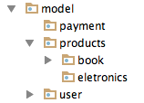
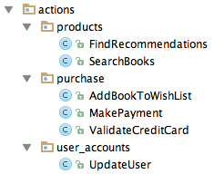
Answering the two original questions
What is the application about? (main concepts)
Expressed by nouns
What does the application do? (main capabilities)
Expressed by verbs
(Actions)

Slide 46
Developer: Great! But what about transactions, security, logging, legacy code, scalability, performance, …?

Slide 47
Manager: OK. Interesting. But why should we care about all this? What is the business value?
Notes:
Businesses can move just as fast as they can create or change software, making them hostages of their own software.

Slide 48

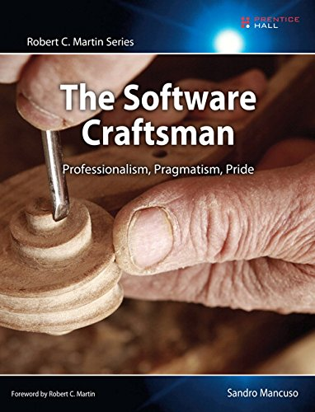

Slide 49

Notes:
Codurance:
We believe that softtware dev is a craft.
We believe that how it is done is as important as getting it done.
We believe that delivering well-crafted code is the best way we can help our clients.

Slide 50

Thank You
@sandromancuso
Notes:
Codurance: We believe that softtware dev is a craft. We believe that how it is done is as important as getting it done.
We believe that delivering well-crafted code is the best way we can help our clients.

